Slide 1
EFI BIOS介绍
亢曼曼
2021/7/11

Slide 2
EFI简介
EFI Framework
BIOS
UEFI BIOS vs 传统BIOS
Rom Image

Slide 3
EFI简介
EFI 全名为Extensible Firmware Interface
是由Intel首先倡导推出的，它定义了固件与操作系统以及Option ROMs之间的接口，不涉及到操作系统层面
UEFI 全名为Unified Extensible Firmware Interface
作为一个技术论坛组织，负责EFI的发展架构
Framework则是实现EFI的完整解决方案
Tinao是Intel的EFI 产品
Aptio是AMI的EFI 产品
H2O是Insyde的EFI产品

Slide 4
EFI简介
EFI的基本概念
Services
BS，RT，Driver，Application
GUID
128bit的全局唯一标识符
Protocol
Interface structure
Handle
Database

Slide 5
EFI Framework
Chipset/Processor
Function DXE Driver specs
OEM, ISV &
Intel BU EFI Driver specs
EFI Framework的目标
C语言(99%)
标准化
模块化
DXEDriver
DXE Driver
DXE
Driver
DXE Driver
DEXE Driver
EFI Driver
EFI Driver
EFI
Driver
CSM
Architecture Specification
DXE
Driver
• • •
EFI
Driver
DXE
Driver
DXE
Driver
EFI
Driver
Driver Execution Environment (DXE)
Spec
Pre-EFI Initialization (PEI)
Spec
CPU Module
Spec(s)
CS Module
Spec(s)

Slide 6
EFI Framework
legacy OS
Loader
legacy Option ROMs
Framework:
Pre-EFI Foundation
DXE Foundation
Framework Drivers
Architectural Protocols
Platform Drivers
EFI Driver
Compatibility Support Module (IA-32 only)
EFI OS Loader
EFI OS Loader
EFI
EFI
Framework Drivers
Platform
Drivers
EFI
Drivers
Compatibility Support Module
Driver Execution Environment
PEI Modules
DXE Foundation
PEI Foundation
Hardware
Hardware

Slide 7
Framework
Exposed
Platform Interface
Pre Verifier
OS-Absent App
CPU Init
verify
Transient OS Environment
Chipset Init
Device, Bus, or Service Driver
Board Init
Transient OS Boot Loader
EFI Driver Dispatcher
Boot Manager
OS-Present App
Intrinsic Services
Final OS Boot Loader
Final OS Environment
?
security
Security
(SEC)
Pre EFI
Initialization (PEI)
Driver Execution Environment (DXE)
Boot Dev
Select (BDS)
Transient System Load
(TSL)
Run Time
(RT)
After Life
(AL)
Power on
[ . . Platform initialization . . ]
[ . . . . OS boot . . . . ]
Shutdown

Slide 8
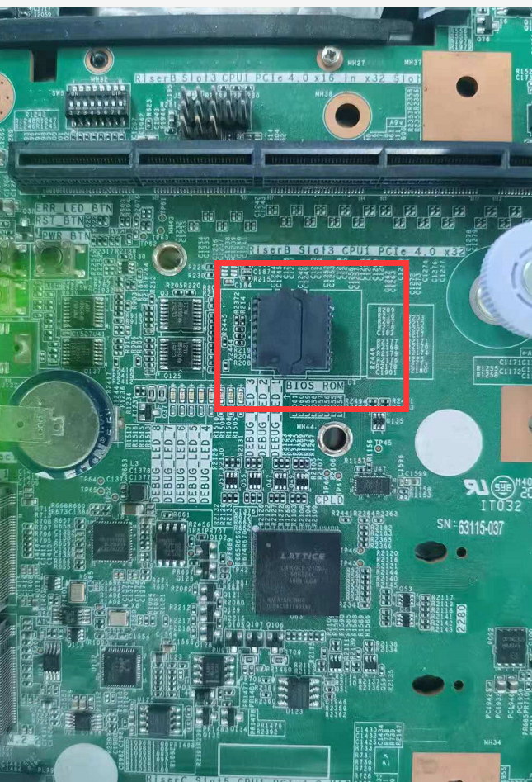
BIOS
它是一片闪存（Flash Memory）芯片
保存有计算机基本输入输出程序
系统设置信息
开机自检程序等
常见的生产产商：
AMI
Phoenix
Insyde

Slide 9
BIOS工作原理
当前CPU 上电执行代码从哪开始？
F000：FFF0 VS FFFFFFF0
DUMP: CR0.PE = 0 表明 CPU处于 real mode
在 FFFFFFF0 内存里的
第 1 条指令典型地是
far jmp 远跳转指令
CPU的第 1 条指令最大的目的是
刷新 cs 寄存器
CS.base = 0000_0000_FFFF_0000 以及
RIP = 0000_0000_0000_FFF0 从物理上决定了
CPU的 第一条指令位于：FFFF_FFF0h（CS.base + RIP）中
电源开启
CPU BIST
读取BIOS代码并执行
芯片组初始化
内存子系统初始化
BIOS解压缩到系统的Memory开始执行。
键盘、磁盘装置、输出输入 、PCI初始化等等
交出控制权给OS

Slide 10
UEFI BIOS vs 传统BIOS
与传统BIOS相比，EFI通过模块化、C语言的参数堆栈传递方式和动态链接的形式构建系统，较BIOS而言更易于实现，容错和纠错特性更强。
 | Legacy BIOS | EFI
Language | Assembly | C (99%)
Resource | Interrupt Hardcode Memory Access Hardcode I/O Access | Driver \ Protocols
Processor | x86 16-bits | CPU Protected Mode (Flat Mode)
Target | Binary Code | Removable Binary Drivers
Expand | Hook Interrupt | Load Driver
OS Bridge | ACPI (SMI, INT Service) | RunTime Driver Service AED (ACPI EFI Protocol Driver) (ACPI, SMI)
3rd Party ISV & IHV | Bad for Support | Easy for Support and for Multi Platforms

Slide 11
Rom Image
UEFI BIOS Rom Image是由许多个FV组成，固有的三个：FV_BB，FV_MAIN, FV_NVRAM
EFI
_{ROM}
_{FV}
_{FFS}
_{FV}
_{FFS}
FV_BB
_{section}
_{FFS}
_{FV}
_{FFS}
_{section}
FV_MAIN
_{FFS}
_{section}
_{FV}
_{FFS}
FV_NV

Slide 12
Rom Image
_{FV}
typedef struct {
EFI_GUID Name;
EFI_FFS_INTEGRITY_CHECK IntegrityCheck;
EFI_FV_FILETYPE Type;
EFI_FFS_FILE_ATTRIBUTES Attributes;
UINT8 Size3];
EFI_FFS_FILE_STATE State;
} EFI_FFS_FILE_HEADER;
_{FFS}
_{FFS}
_{FFS}
_{FFS}
.DXS
_{FFS}
Image Entry
Other

Slide 13
Rom Image
typedef struct {
UINT8 Size[3];
EFI_SECTION_TYPE Type;
} EFI_COMMON_SECTION_HEADER;
_{FFS}
_{HEADER}
_{SECTION}
_{SECTION}
_{SECTION}
EFI_SECTION_DXE_DEPEX
_{SECTION}
Dependency Expression

Slide 14
UEFI Spec
EFI Specification Version 1.02
December 12, 2000
EFI Specification Version 1.10
December 1, 2002
EFI Driver Model
Unified Extensible Firmware Interface Specification Version 2.0
January 32,2006
UEFI Driver Model
http://www.uefi.org/home
UEFI Specification Version 2.3.1
April 6,2011
The EFI Driver Model is designed to be generic and can be adapted to any type of bus or device.

